Slide 1
Data Mining Assignment
HR Employee Attrition Analysis

Slide 2
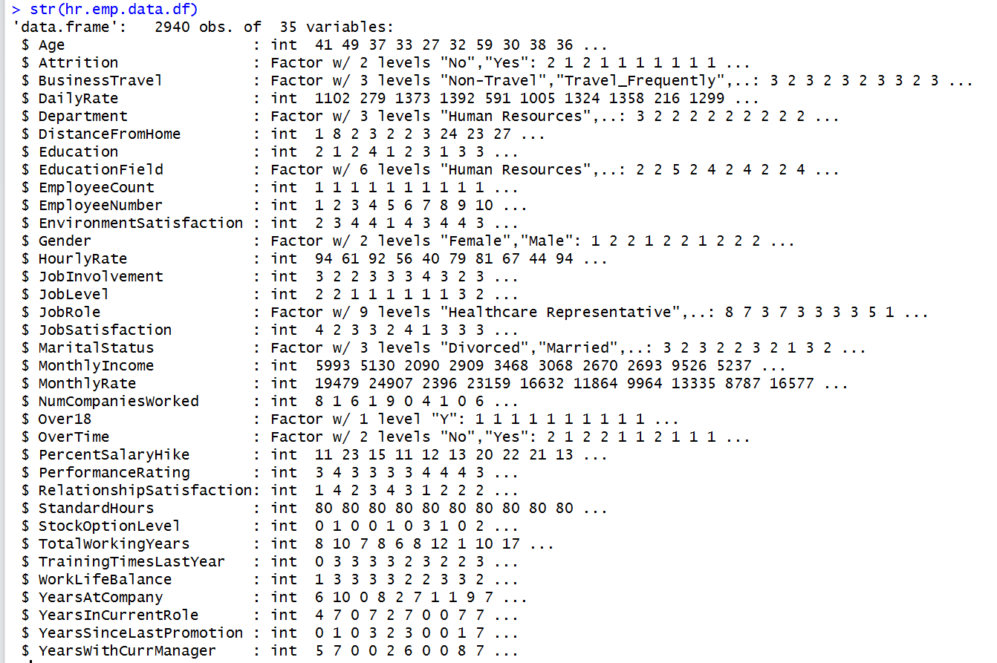
Reading Data and Preprocessing

Slide 3

Reading Data and Preprocessing
# no null values in the data
# Education, EnvironmentSatisfaction, JobInvolvement, JobLevel, JobSatisfaction, NumCompaniesWorked, StockOptionLevel,
# TrainingTimesLastYear, WorkLifeBalance, PerformanceRating, RelationshipSatisfaction can be converted into factors
# converting the above variables into factors
hr.emp.data.df$Education <- as.factor(hr.emp.data.df$Education)
hr.emp.data.df$EnvironmentSatisfaction <- as.factor(hr.emp.data.df$EnvironmentSatisfaction)
hr.emp.data.df$JobInvolvement <- as.factor(hr.emp.data.df$JobInvolvement)
hr.emp.data.df$JobLevel <- as.factor(hr.emp.data.df$JobLevel)
hr.emp.data.df$JobSatisfaction <- as.factor(hr.emp.data.df$JobSatisfaction)
hr.emp.data.df$StockOptionLevel <- as.factor(hr.emp.data.df$StockOptionLevel)
hr.emp.data.df$WorkLifeBalance <- as.factor(hr.emp.data.df$WorkLifeBalance)
hr.emp.data.df$PerformanceRating <- as.factor(hr.emp.data.df$PerformanceRating)
hr.emp.data.df$RelationshipSatisfaction <- as.factor(hr.emp.data.df$RelationshipSatisfaction)

Slide 4
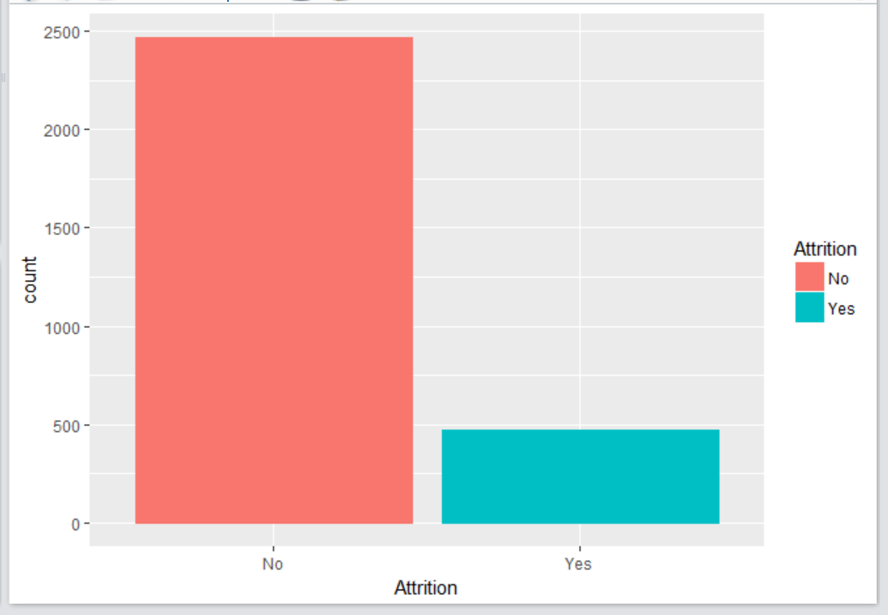
Reading Data and Preprocessing
unique(hr.emp.data.df$EmployeeCount) # one value of 1
unique(hr.emp.data.df$EmployeeNumber) #Employee ID value
we can conclude that EmployeeCount and EmployeeNumber are not significant variables and we can leave out these
2 variables while building the model
Over18 # only one value of Y
since only one value hence not significant for the model
unique(hr.emp.data.df$StandardHours) # 80
since only one value hence not significant for the model

Slide 5
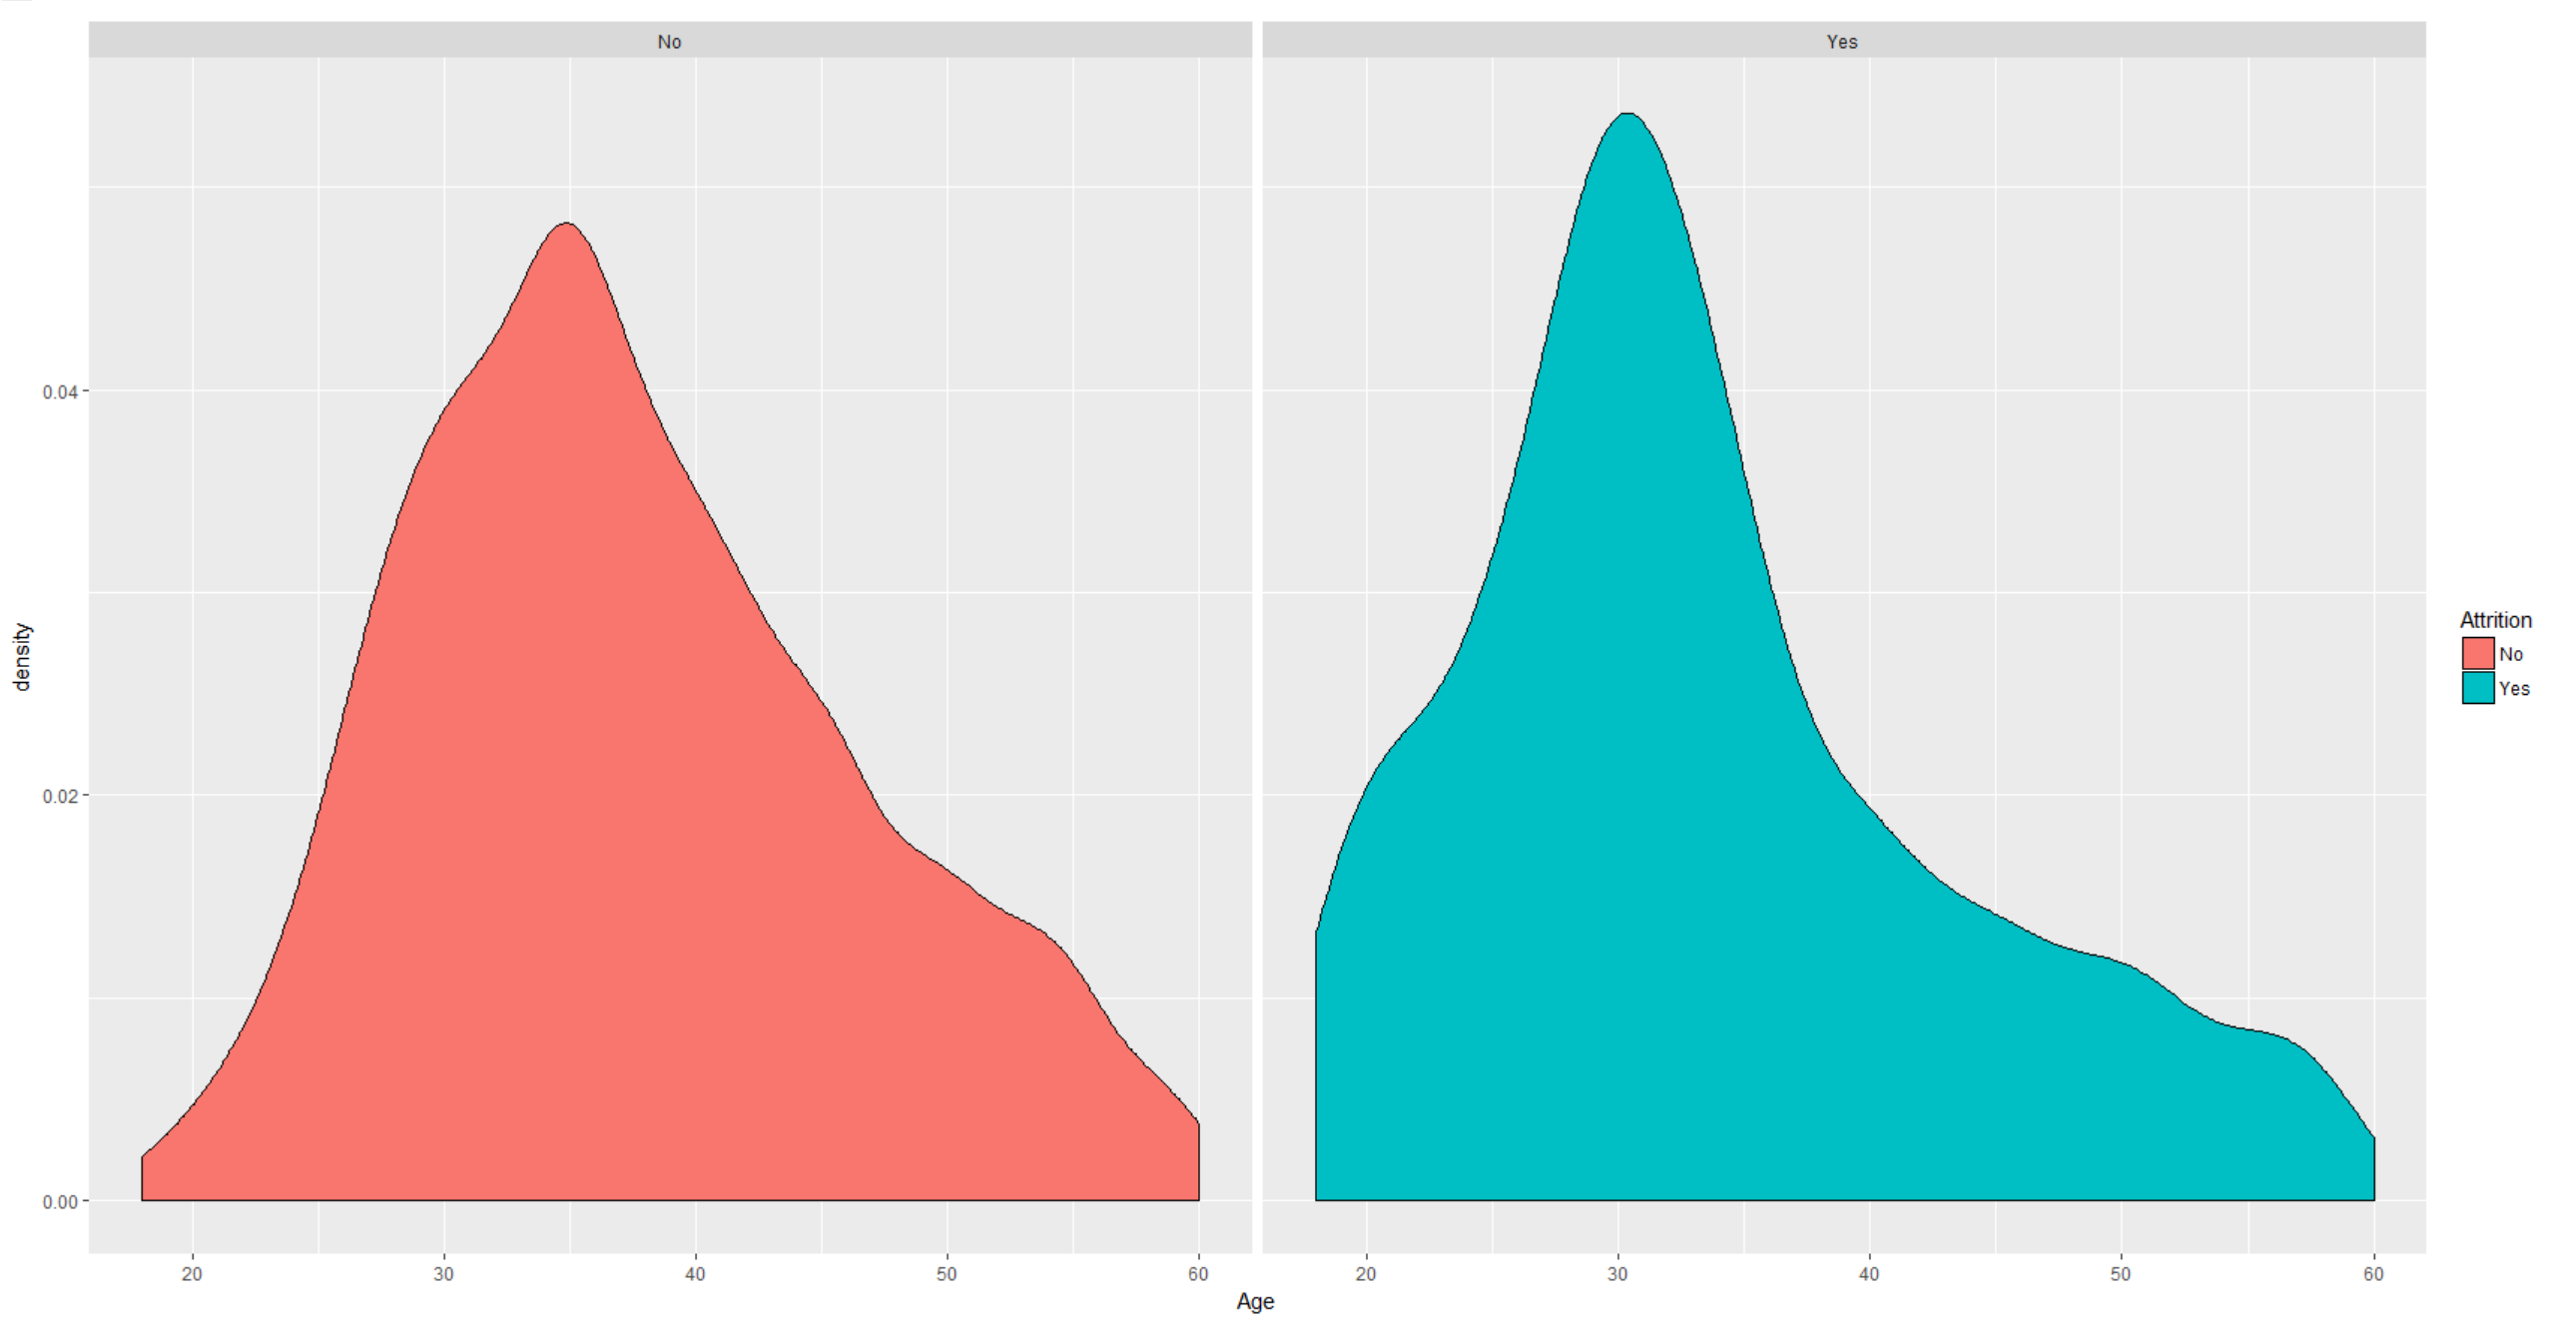
Exploratory Data Analysis…Age and Attrition
Majority of employees leaving the organization are around 30 years.

Slide 6
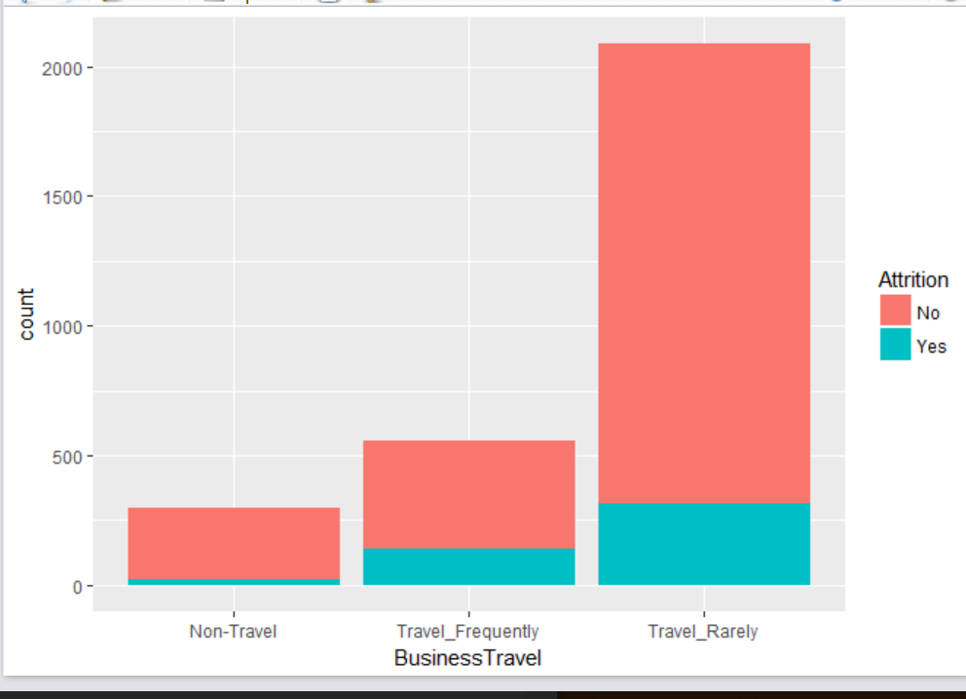
Exploratory Data Analysis…Business Travel and Attrition
More attrition in the Travel groups

Slide 7
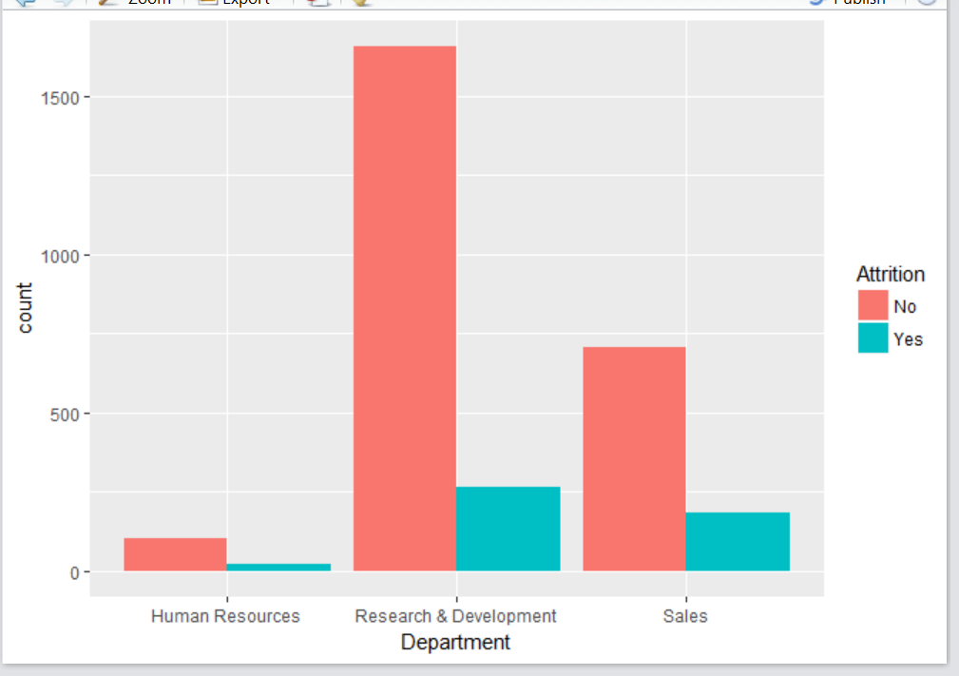
Exploratory Data Analysis…Department and Attrition
low attrition in HR because of low population in HR group

Slide 8
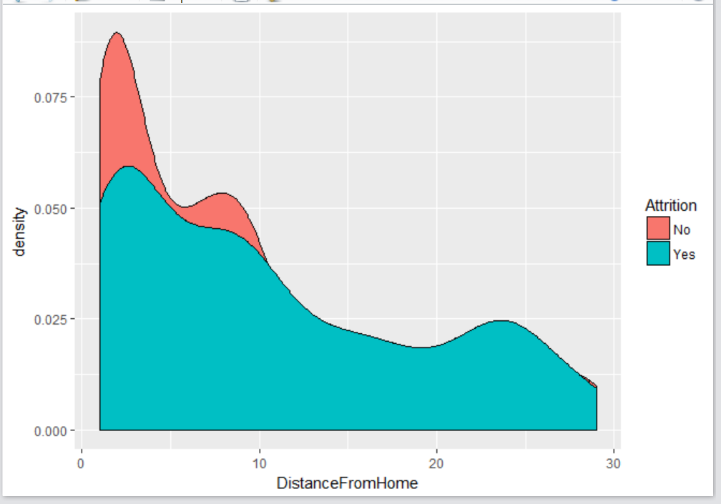
Exploratory Data Analysis…DistanceFromHome and Attrition
More attrition where distance from office to home is less

Slide 9
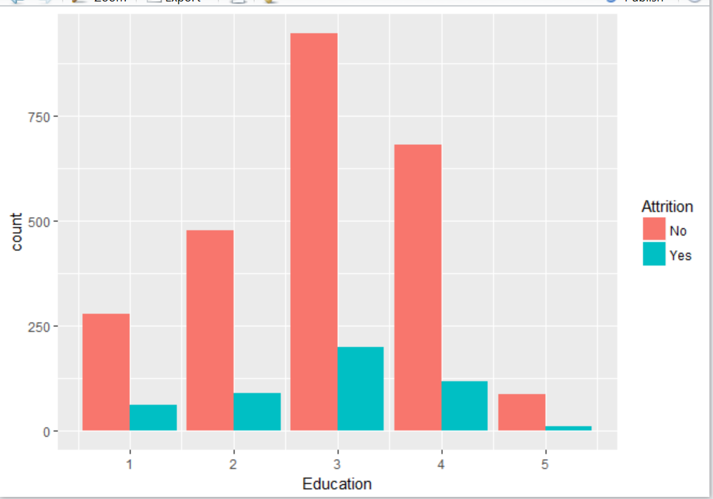
Exploratory Data Analysis…Education and Attrition
level 5 is doctor and very low attrition due to low representation

Slide 10
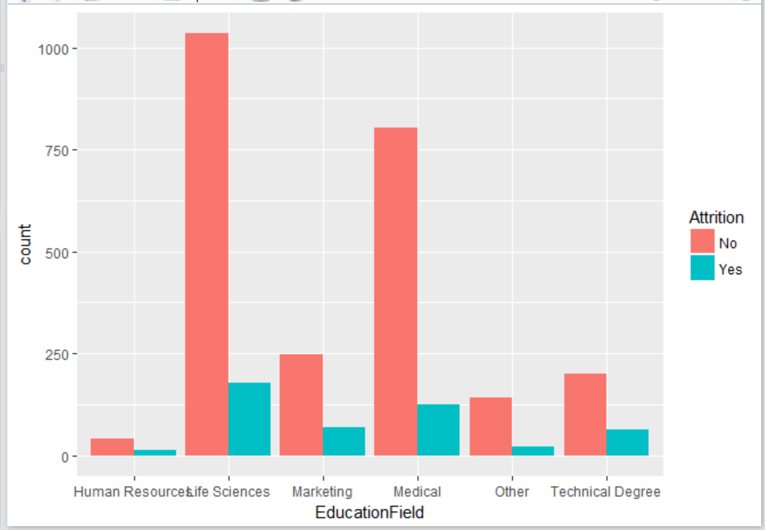
Exploratory Data Analysis…EducationField and Attrition
very low attrition due to low representation of HR group

Slide 11
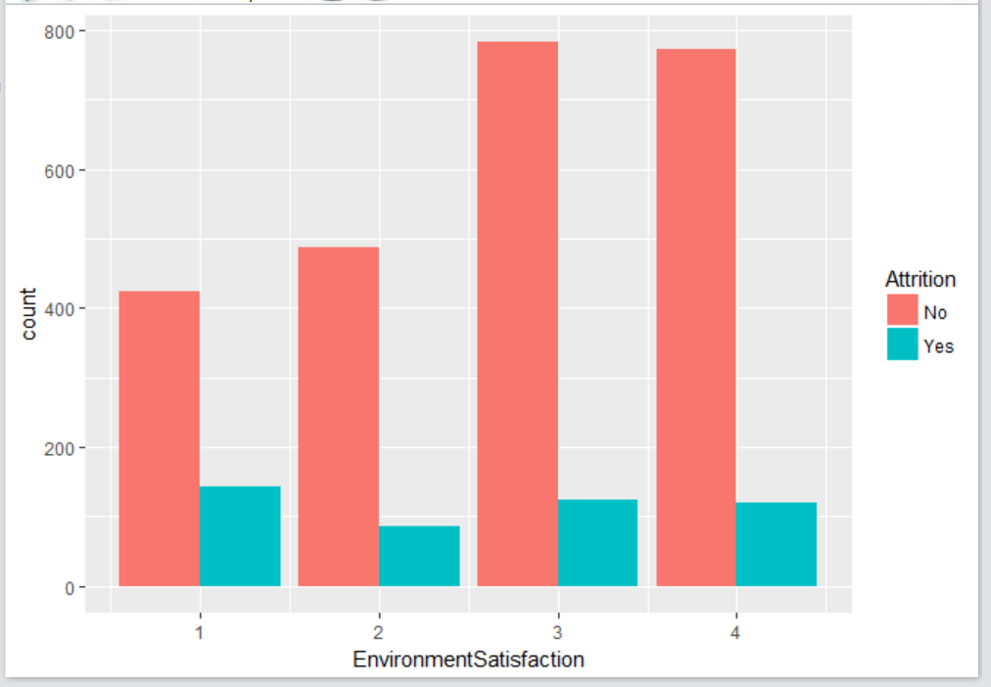
Exploratory Data Analysis…EnvironmentSatisfaction and Attrition
Can’t deduce any relevant analysis from the plot

Slide 12
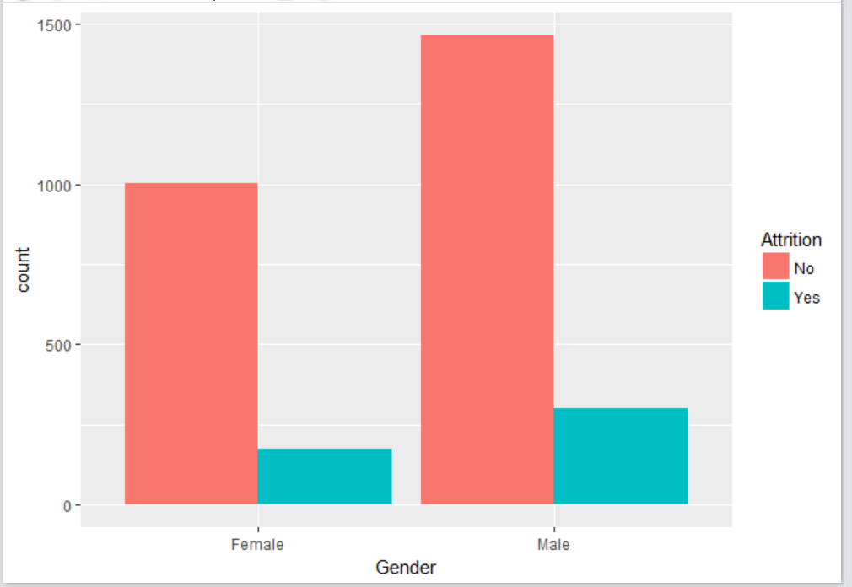
Exploratory Data Analysis…Gender and Attrition
Can’t say much from the plot

Slide 13
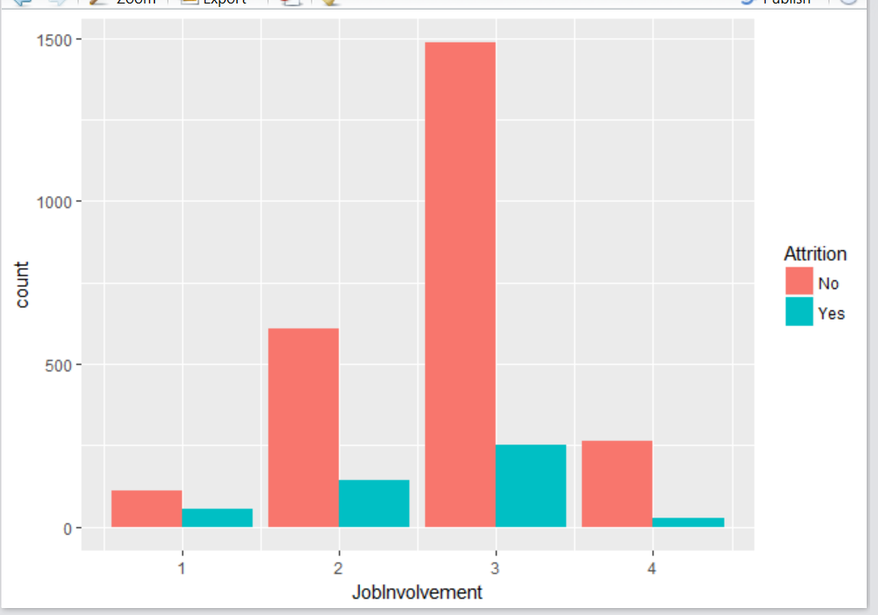
Exploratory Data Analysis…JobInvolvement and Attrition
high attrition for low involved jobs

Slide 14
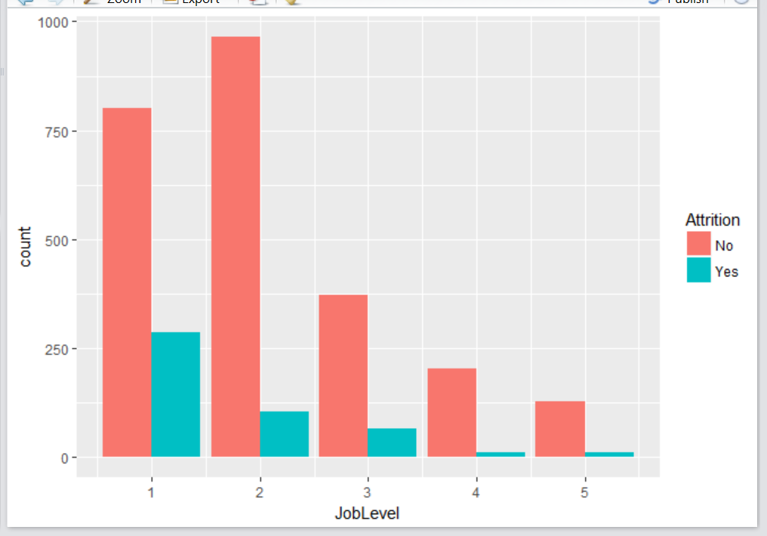
Exploratory Data Analysis…JobLevel and Attrition
as job level increase from 1 to 5, the attrition rate decreases

Slide 15
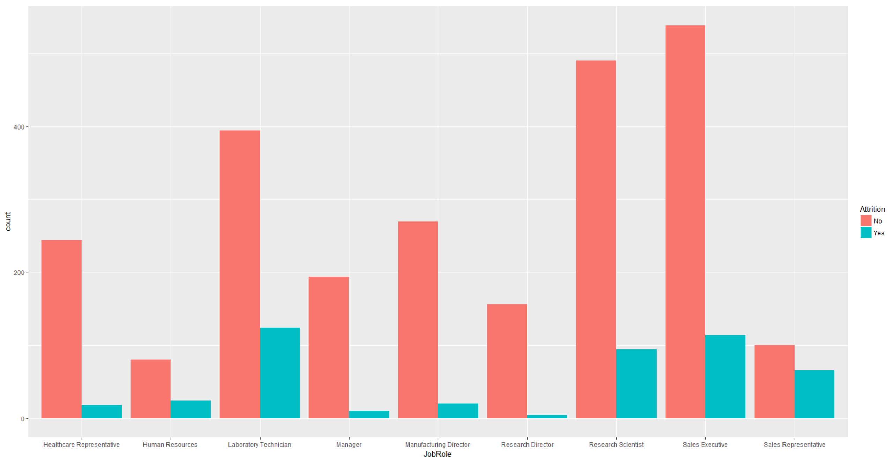
Exploratory Data Analysis…JobRole and Attrition
the Sales Representative job role has significantly more attrition relative to other job roles.

Slide 16
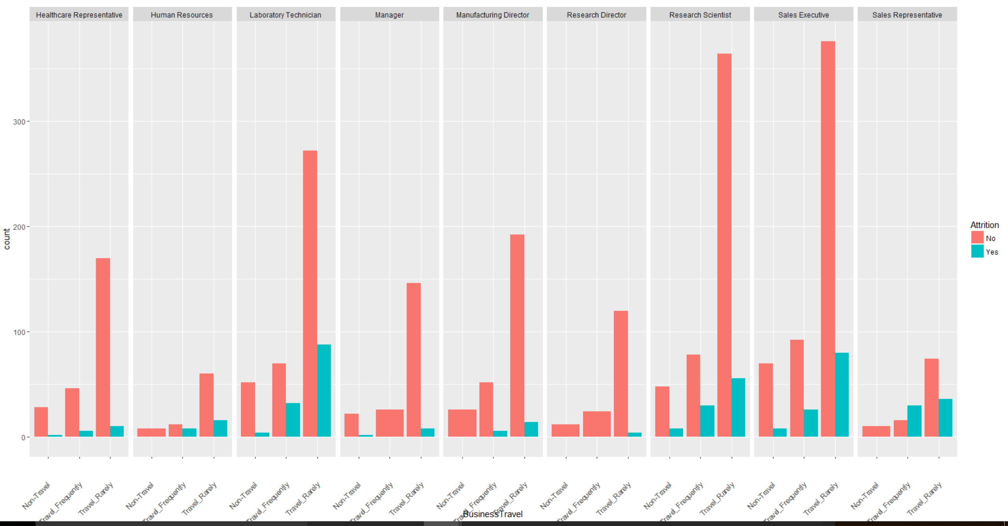
Exploratory Data Analysis…JobRole and BusinessTravel and Attrition
sales representatives that travel frequently have very high attrition rates

Slide 17
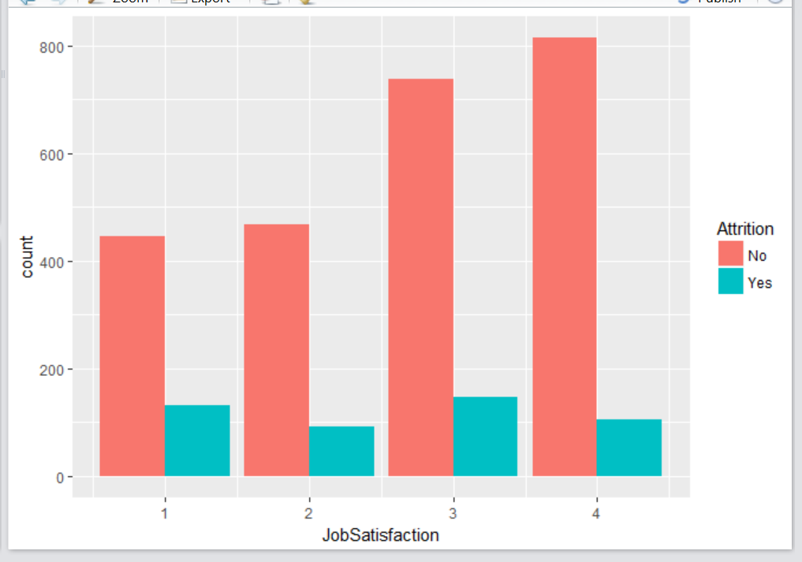
Exploratory Data Analysis…JobSatisfaction and Attrition
Can’t say much from the plot

Slide 18
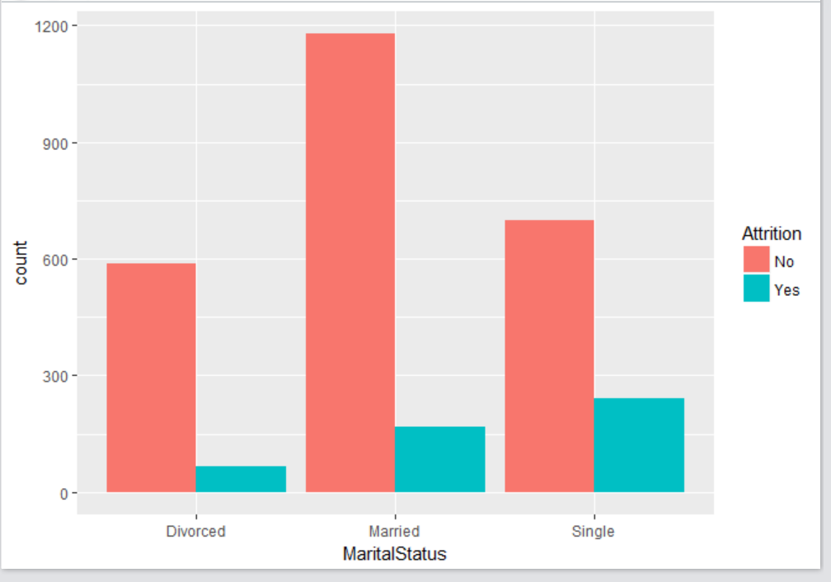
Exploratory Data Analysis…MaritalStatus and Attrition
attrition rate higher for Single and lowest for divorced

Slide 19
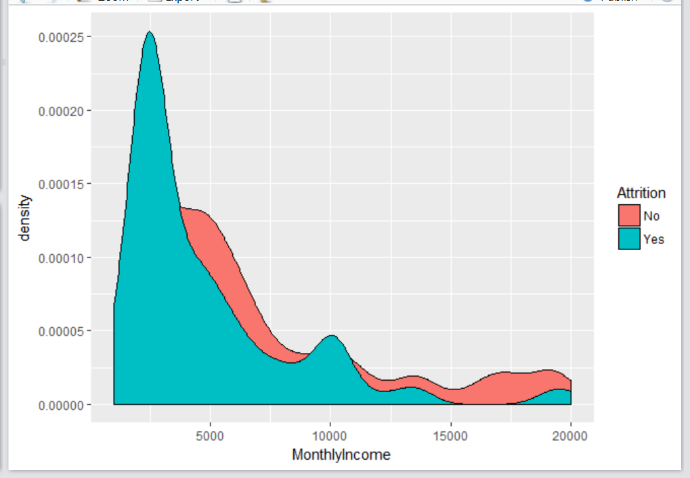
Exploratory Data Analysis…MonthlyIncome and Attrition
high attrition corresponds to low monthly income

Slide 20
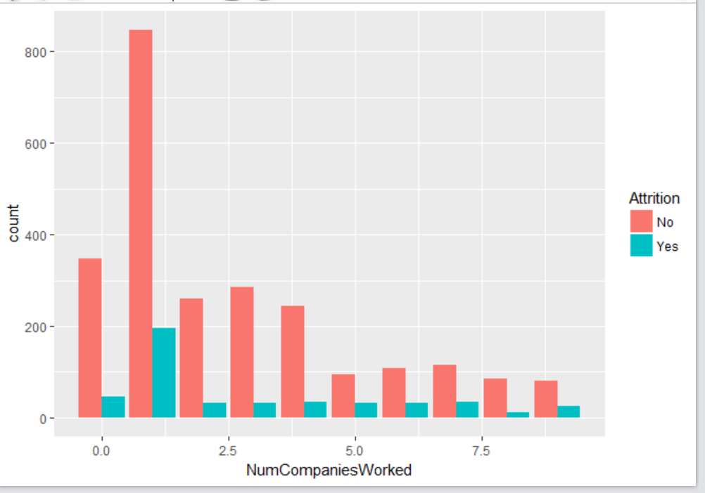
Exploratory Data Analysis…NumCompaniesWorked and Attrition
attrition higher for people who worked in 1 company before or new to the company with no experience

Slide 21
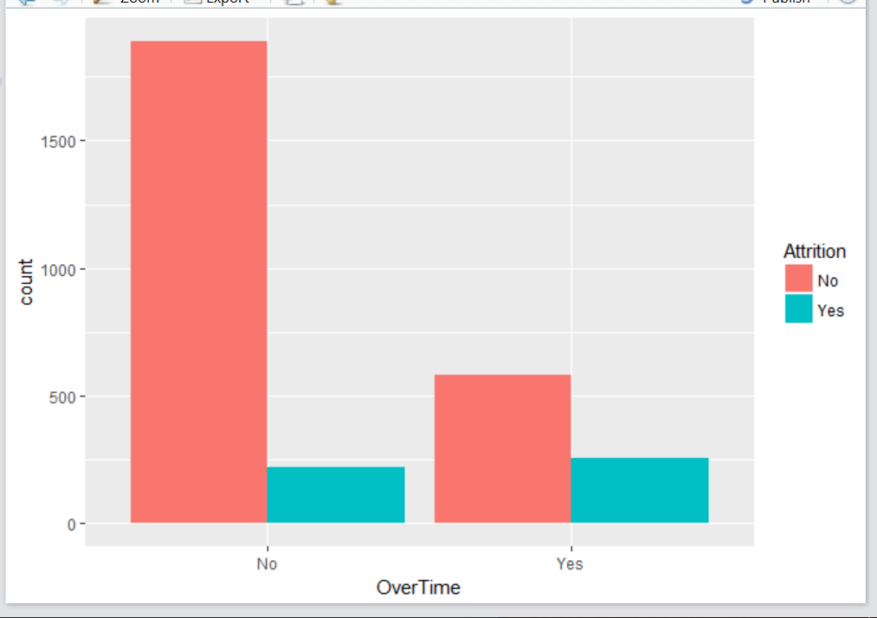
Exploratory Data Analysis…OverTime and Attrition
overtime employees have significantly higher attrition rates as compared to employees with no overtime.

Slide 22
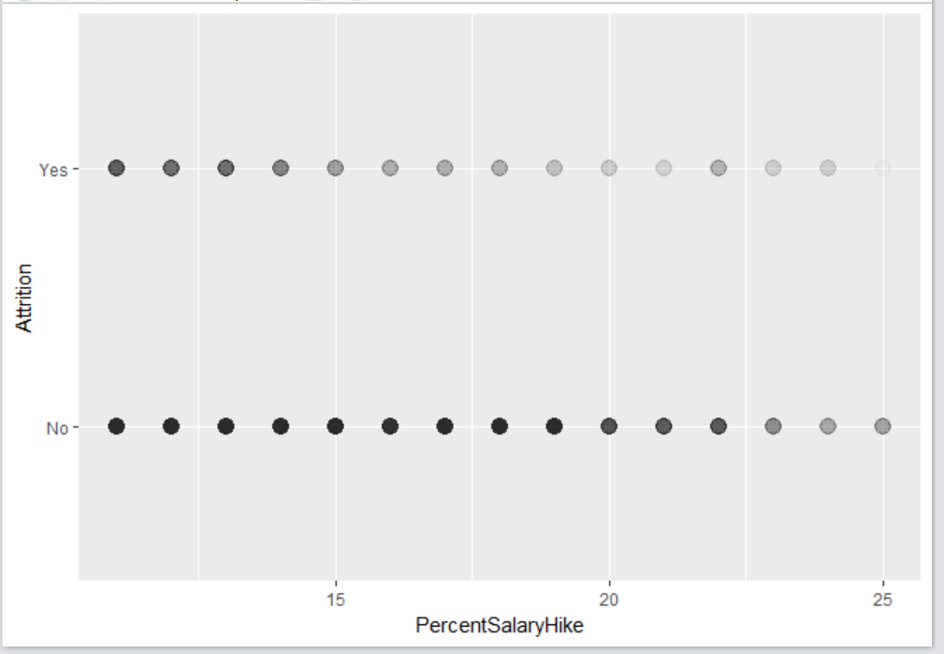
Exploratory Data Analysis…PercentSalaryHike and Attrition
high attrition for employees with less than 15% hike

Slide 23
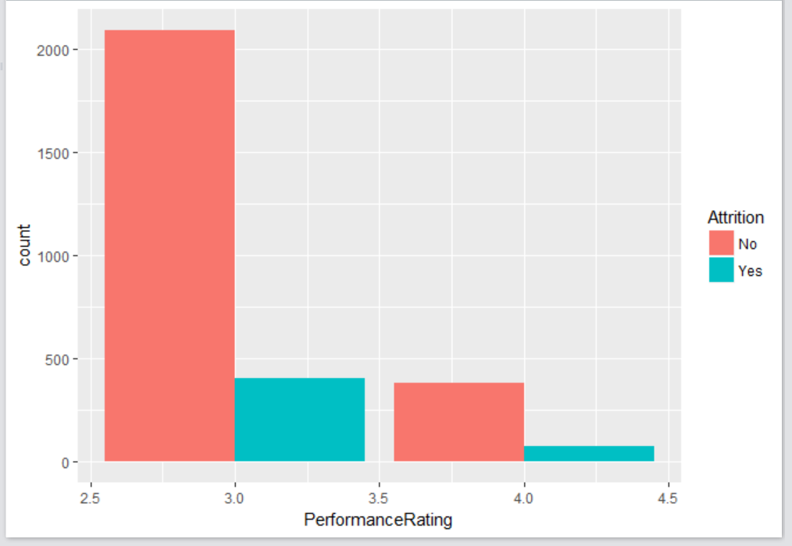
Exploratory Data Analysis…PerformanceRating and Attrition
less attrition for rating 4

Slide 24
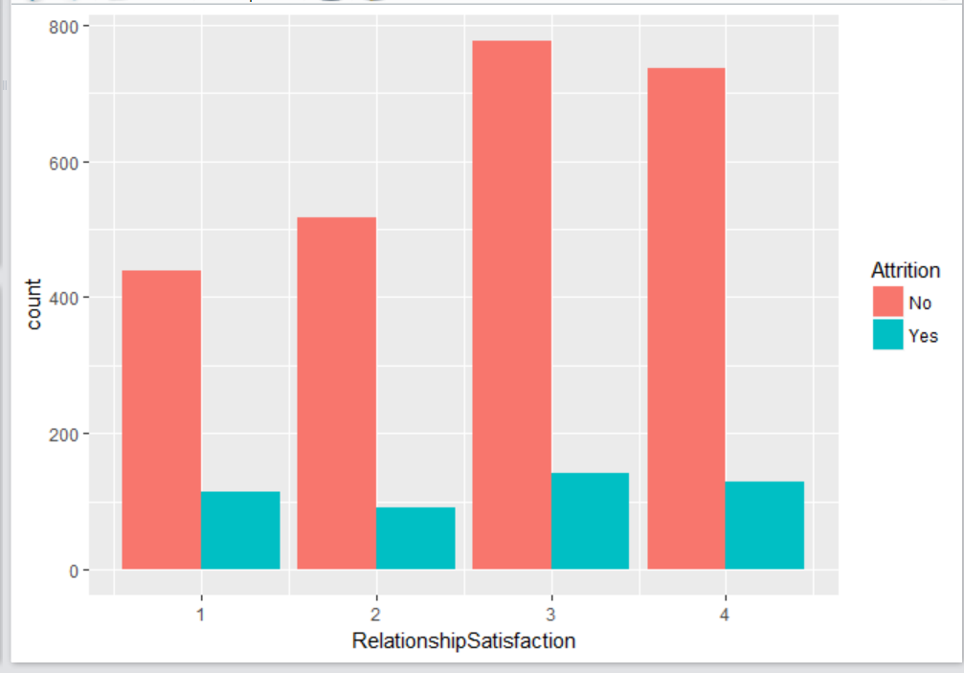
Exploratory Data Analysis…RelationshipSatisfaction and Attrition
proportion of attrition high in 1 and 2 level of Relationship Satisfaction

Slide 25
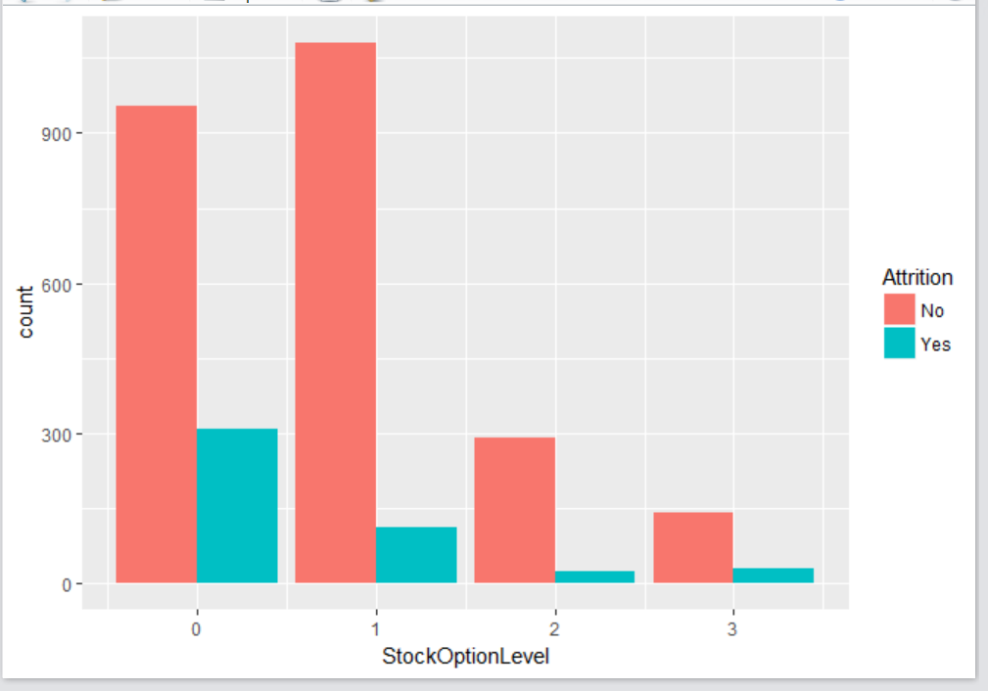
Exploratory Data Analysis…StockOptionLevel and Attrition
High attrition with no stockoptionlevel level

Slide 26
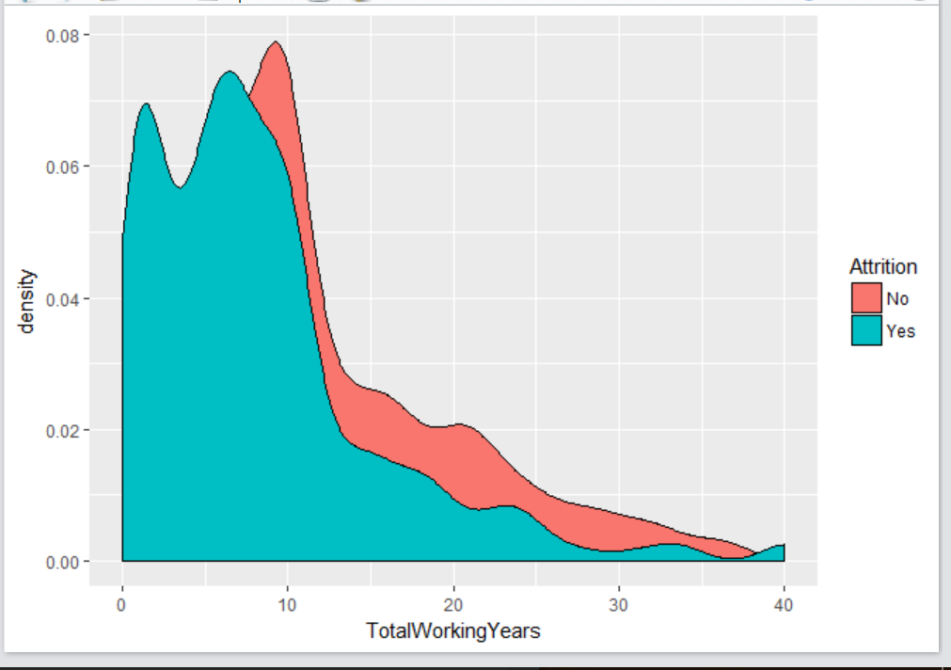
Exploratory Data Analysis…TotalWorkingYears and Attrition
High attrition for less totalworkingyears <=10 years

Slide 27
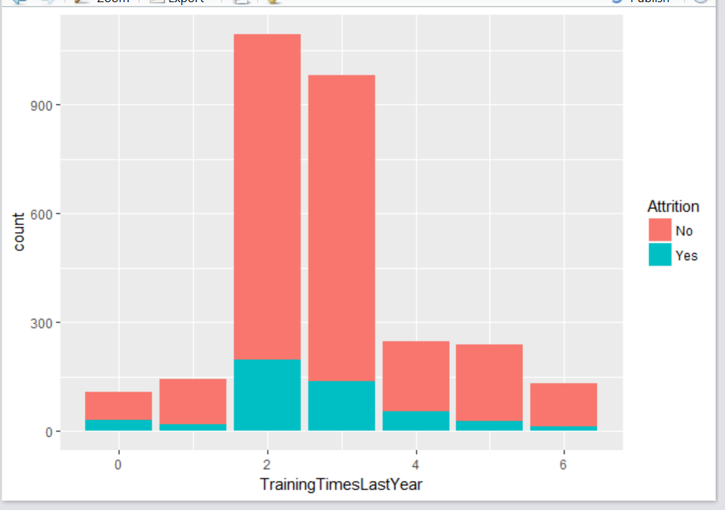
Exploratory Data Analysis…TrainingTimesLastYear and Attrition
high attrition for level of 2 and 3

Slide 28
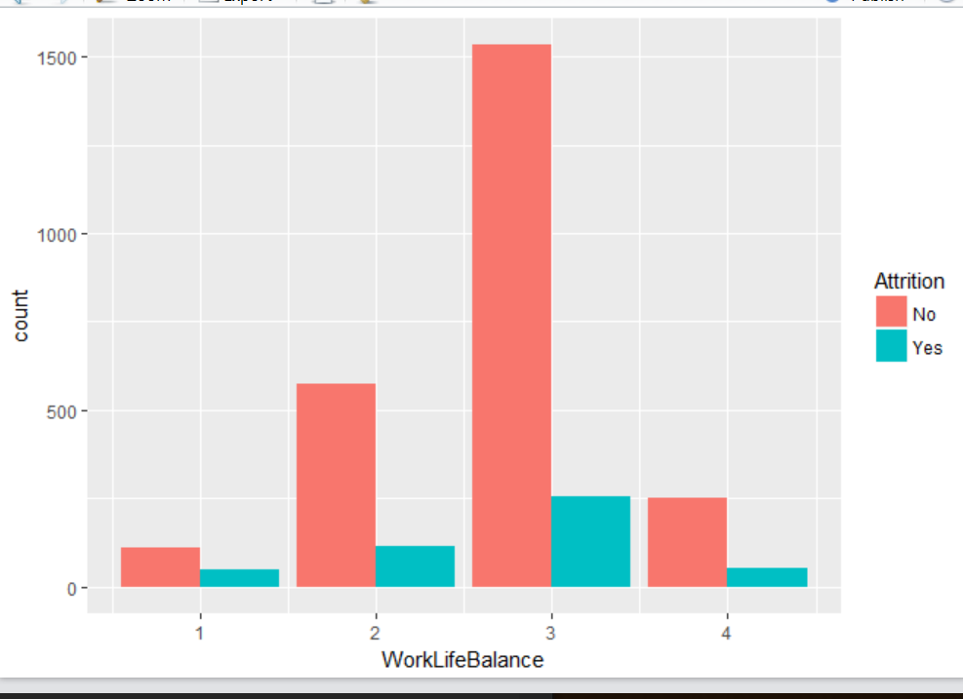
Exploratory Data Analysis…WorkLifeBalance and Attrition
high attrition for 1/2/3 levels

Slide 29
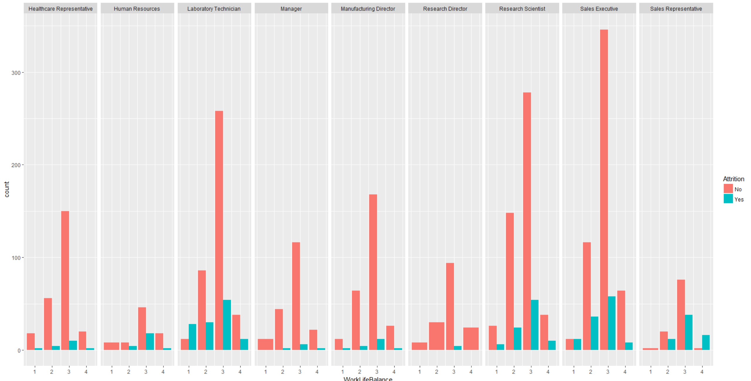
Exploratory Data Analysis…WorkLifeBalance and JobRole and Attrition
high attrition for Sales Representative and Lab Technicians at worklifebalance at level 2 and 3

Slide 30
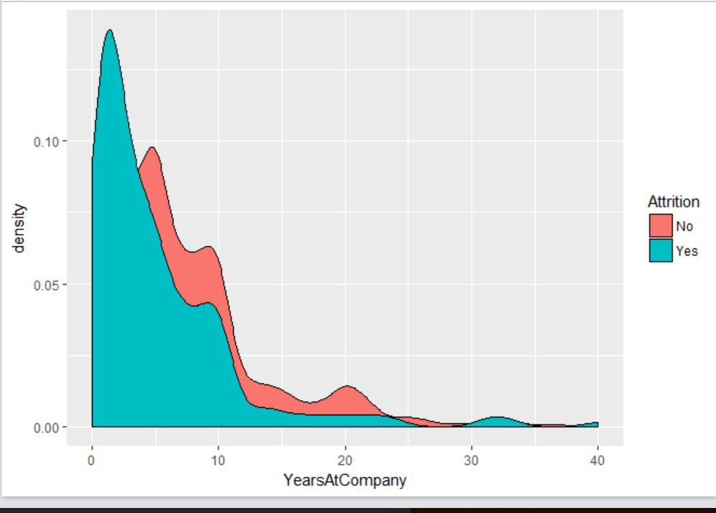
Exploratory Data Analysis…YearsAtCompany and Attrition
high attrition when YearsatCompany <=10 years

Slide 31
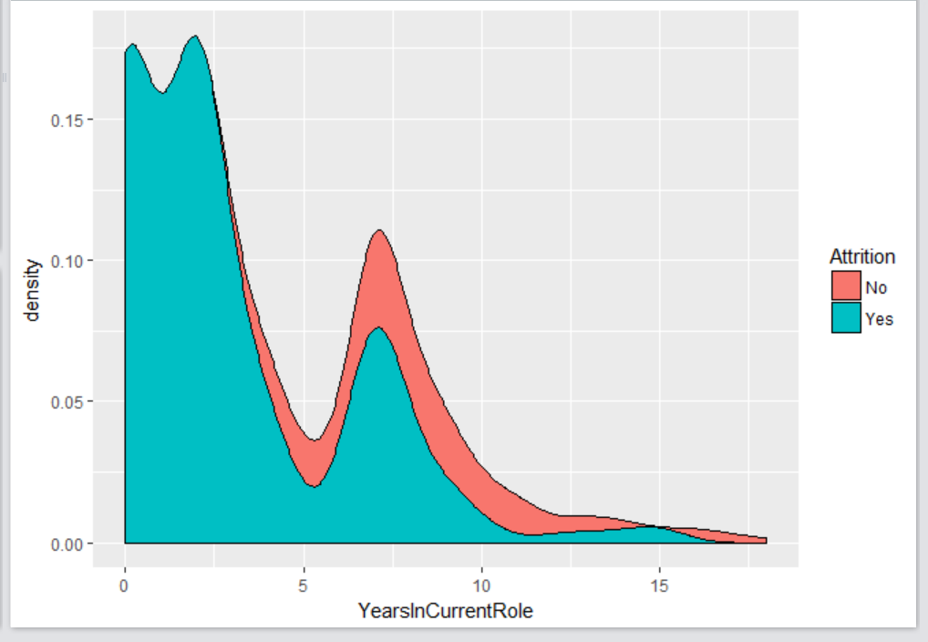
Exploratory Data Analysis…YearsInCurrentRole and Attrition
high attrition when yearsincurrentrole <=5 years

Slide 32
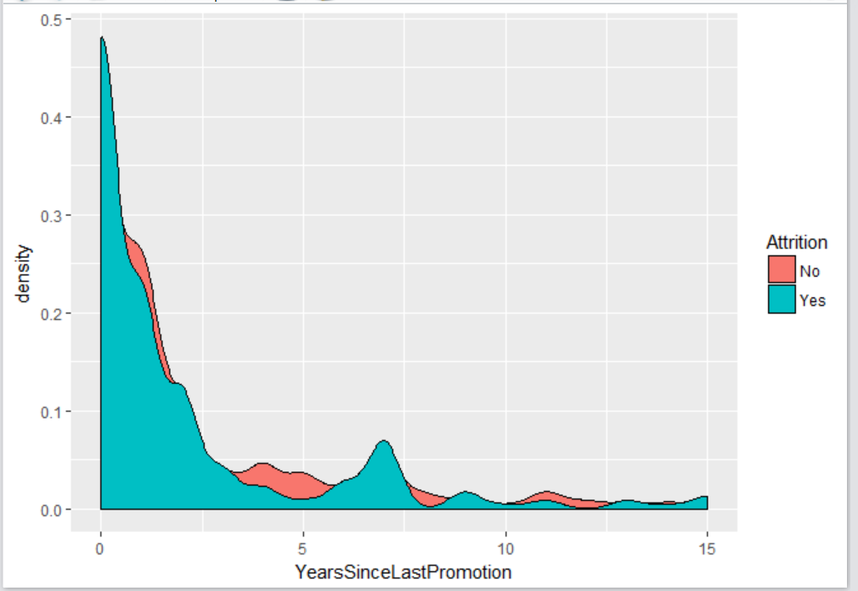
Exploratory Data Analysis…YearsSinceLastPromotion and Attrition
when less number of years then high attrition

Slide 33
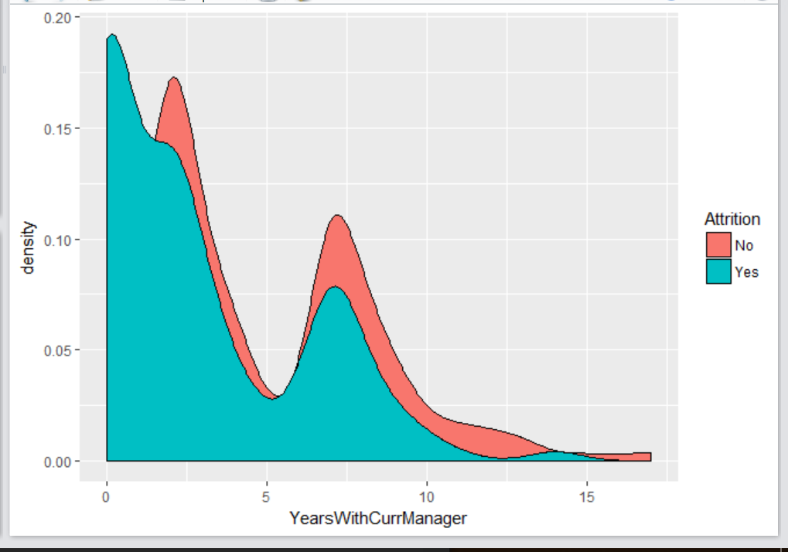
Exploratory Data Analysis…YearsWithCurrManager and Attrition
high attrition when time with new manager is less

Slide 34
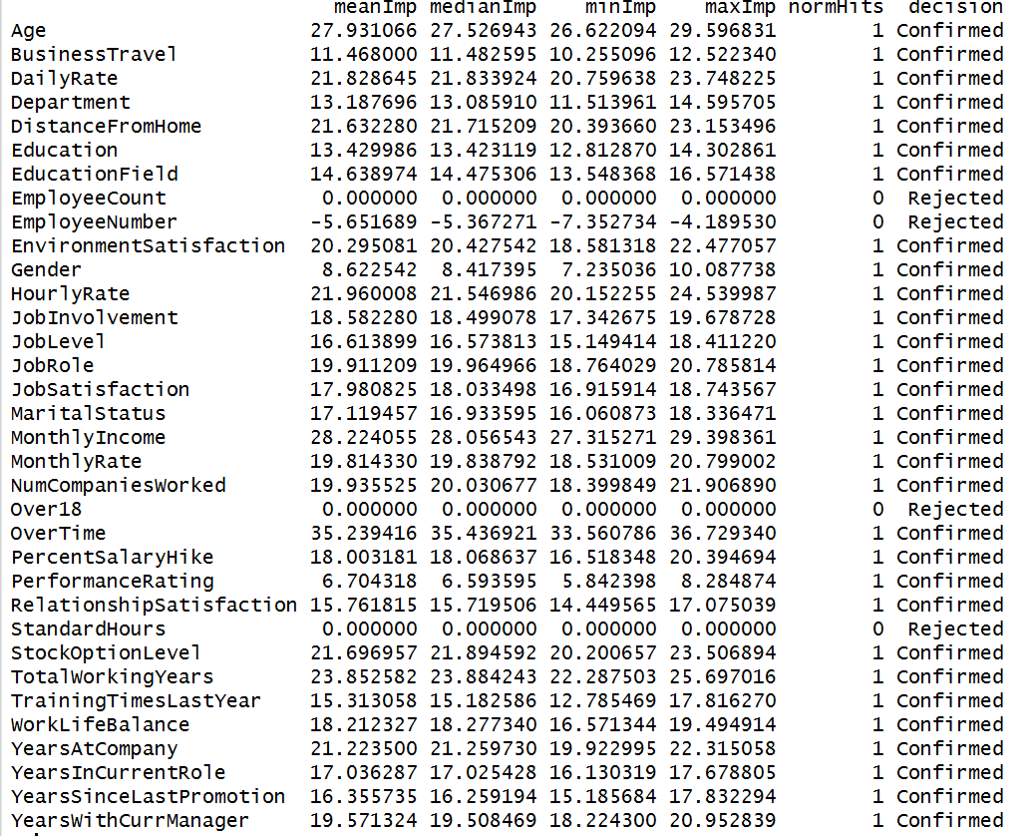
Variable Selection using Baruta Package

Slide 35
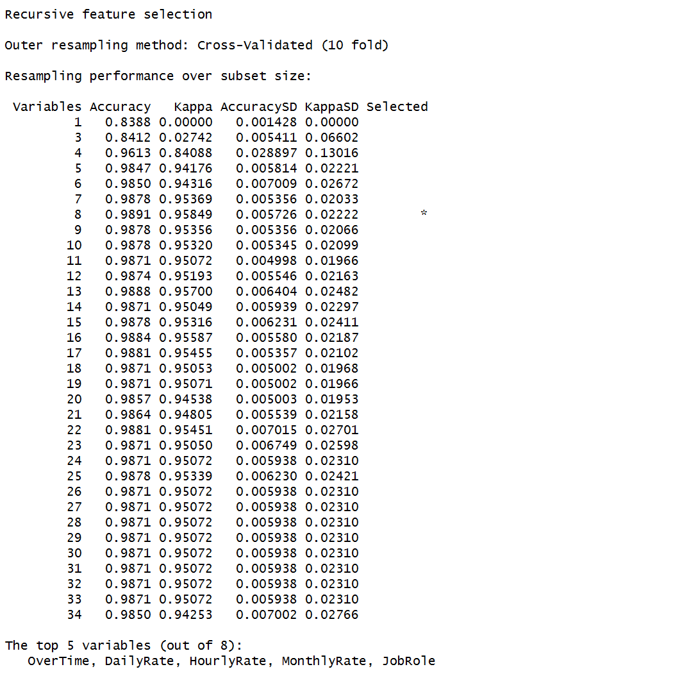
Variable Selection using Caret Package

Slide 36
Variable Selection and Exploratory Data Analysis
We can see that the top 8 variables like OverTime, JobRole, Age,MonthlyIncome etc has significant effect on Attrition as per our initial data analysis.

Slide 37



Random Forest
split 70 percent of the data into the training dataset and 30 percent of the data into the testing dataset:
set.seed(2)
ind = sample(2, nrow(hr.emp.data.df), replace = TRUE, prob=c(0.7,0.3))
train.df = hr.emp.data.df[ind == 1,]
test.df = hr.emp.data.df[ind == 2,
prop.table(table(train.df$Attrition))
prop.table(table(test.df$Attrition))
we see almost equal representation in both training and testing set for the dependent or response variable

Slide 38
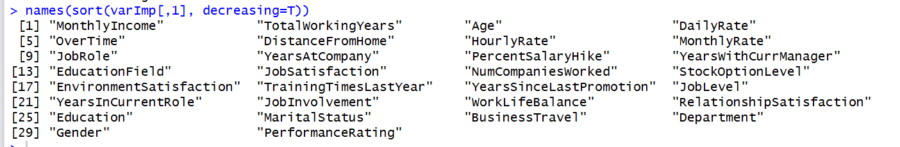
Random Forest and Important Variables
Top 30 variables in the decreasing order of MeanDecreaseGini

Slide 39
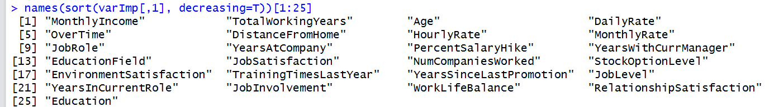
Random Forest
The final model built with top 25 variables and minimum tree of 114.
Accuracy: 0.95, KS=0.82
The top 25 variables given by the variable importance function in random forest:

